Slide 1
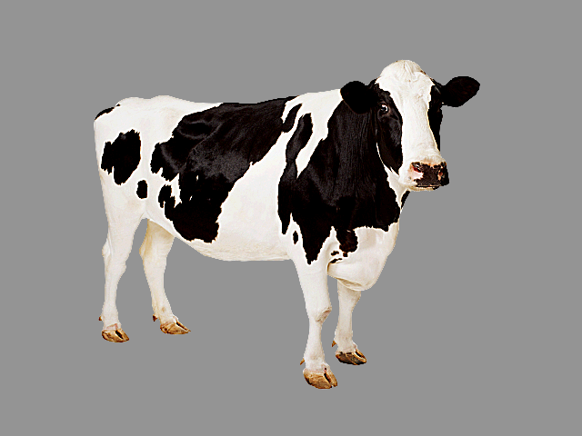
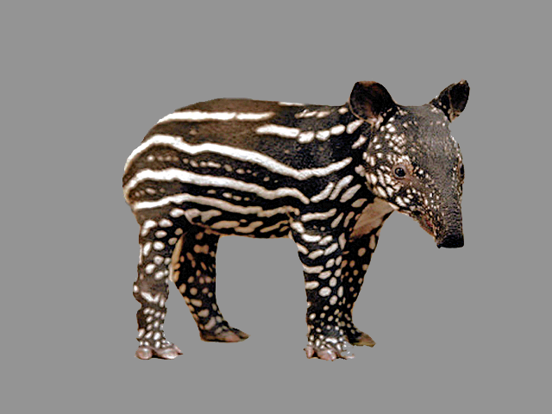
One-to-one biases in a non-linguistic and non-communicative domain:
30-month-olds map novel animal vocalizations to unfamiliar animals
Ricardo A.H. Bion
Kyle MacDonald
Anne Fernald
Stanford University

Slide 2
Why do children chose a novel object when hearing a novel word?
Lexical-specific constraints
de Marchena et al., 2011
Inferences about speakers' communicative intentions
Bloom, 2002; Diesendruck & Markson, 2001
Domain-general learning principles
Regier 2003; Frank, Goodman, Tenenbaum 2009; McMurray et al., 2011
Notes:
During the last 35 years, several studies have shown that children chose a novel object as the referent for novel words.

Slide 3
Are words special for humans?
Words but not tones promote object categorization and individuation in young infants (Fulkerson & Waxman, 2007; Xu, 2002)
Younger infants accept many forms as object labels, but older infants seem to favor words (Namy & Waxman, 1998; Woodward & Hoyne, 1999)
Infants prefer to hear words over some nonlinguistic analogues (Vouloumanos & Werker, 2004, 2007)

Slide 4
Are words special for humans?
Words but not tones promote object categorization and individuation in young infants (Fulkerson & Waxman, 2007; Xu, 2002)
Younger infants accept many forms as object labels, but older infants seem to favor words (Namy & Waxman, 1998; Woodward & Hoyne, 1999)
Infants prefer to hear words over some nonlinguistic analogues (Vouloumanos & Werker, 2004, 2007)
Arbitrary symbolic associations

Slide 5
Are words special for humans?
Words and environmental sounds might be processed differently by adults (Chen & Spence, 2011)
15- and 25-mo-olds can use words and environmental sounds to guide their attention to familiar objects (Cummings et al., 2009)
5-mo-olds can match some animals to their vocalizations (Vouloumanos & Werker, 2004, 2007)

Slide 6
Are words special for humans?
Words and environmental sounds might be processed differently by adults (Chen & Spence, 2011)
15- and 25-mo-olds can use words and environmental sounds to guide their attention to familiar objects (Cummings et al., 2009)
5-mo-olds can match some animals to their vocalizations (Vouloumanos & Werker, 2004, 2007)
Meaningful associations

Slide 7
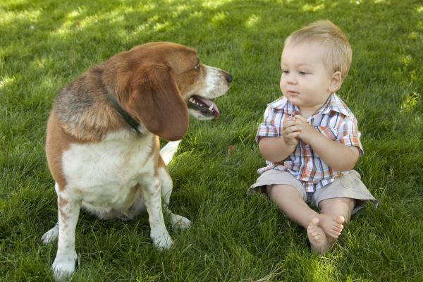
arbitrary
non-arbitrary
animal names
onomatopoeic words
animal vocalizations
look at the
bow-wow!
Woof!
where's the dog?

Slide 8
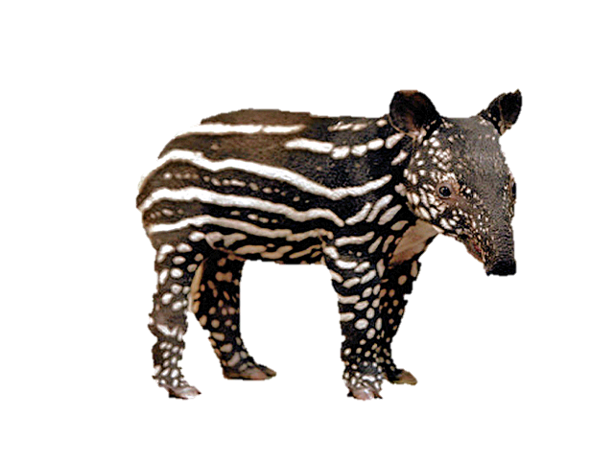
arbitrary
non-arbitrary
novel animal name
novel animal vocalization
novel vocalization
where's the nado?

Slide 9
STUDY 1
How quickly can 30-mo-olds use linguistic and non-linguistic cues to identify a familiar animal?
Do children choose a novel animal in response to a novel animal vocalization?
STUDY 2
If so, do children actually remember the mapping between the novel animal and vocalization?

Slide 10
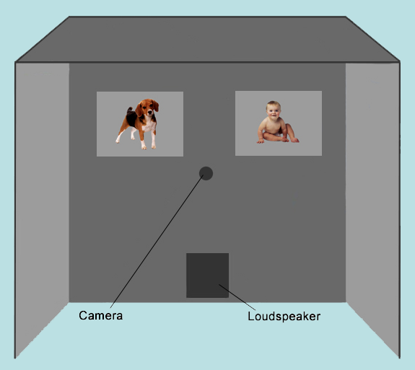
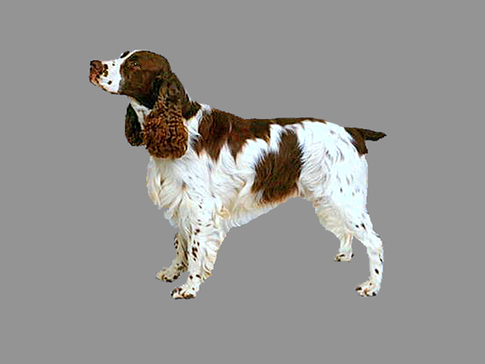
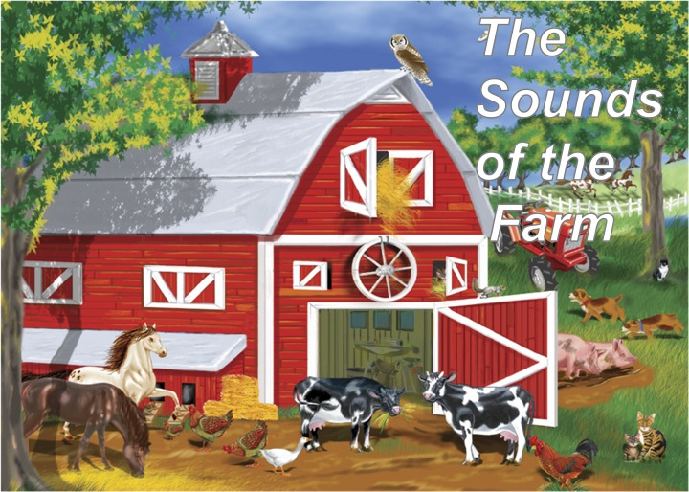
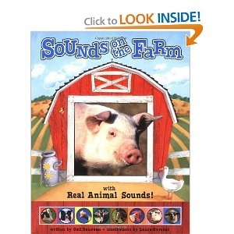
Study 1: DESIGN
21 30-mo-olds
2 Familiarization books
Looking-while-listening task
Accuracy:
Proportion looking to target
[300 to 4300 ms]
Reaction time:
Time to shift to target
[300 to 1800 ms]
Fernald et al. (2008)

Slide 11

Study 1 STIMULI: Familiar-sound
3 TRIAL TYPES
8 ANIMAL-NAME
Where’s the dog?
8 ONOMATOPOEIC-WORD
Which one goes woof-woof?
16 ANIMAL VOCALIZATION
Listen [dog barking]
horse-dog-cow-sheep
30-month-olds (n=21)

Slide 12
STUDY 1
How quickly can 30-mo-olds use linguistic and non-linguistic cues to identify a familiar animal?
Do children choose a novel animal in response to a novel animal vocalization?
STUDY 2
If so, do children actually remember the mapping between the novel animal and vocalization?

Slide 13
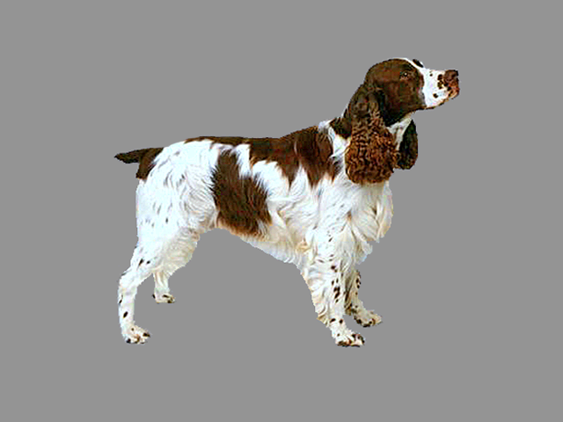
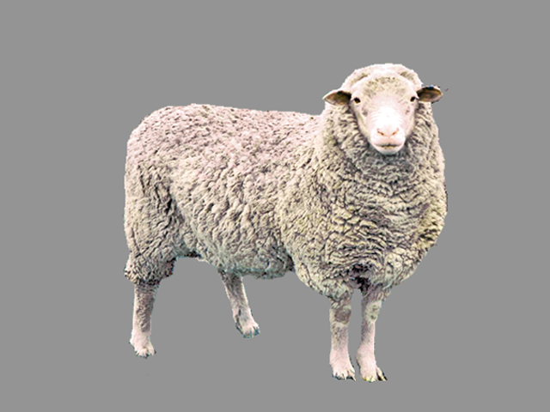
30-mo-olds responded fastest to the familiar animal name and slowest to the familiar animal vocalization
D O G
name
onomatopoeic word
W O O F
animal vocalization
[barking]
Time (ms) from sound onset

Slide 14
30-mo-olds responded fastest to the familiar animal name and slowest to the familiar animal vocalization
D O G
name
Why?
• Frequency
• Design features
• Representational
differences
onomatopoeic word
W O O F
animal vocalization
[barking]
Time (ms) from sound onset

Slide 15
30-mo-olds responded fastest to the familiar animal name and slowest to the familiar animal vocalization
D O G
name
onomatopoeic word
W O O F
animal vocalization
[barking]
Time (ms) from sound onset

Slide 16
Over a 4-s response window, all 3 Familiar sounds were equally effective in drawing children’s attention to a Familiar target animal
NAME ONOMATOPOEIC VOCALIZATION
WORD

Slide 17
STUDY 1
How quickly can 30-mo-olds use linguistic and non-linguistic cues to identify a familiar animal?
Do children choose a novel animal in response to a novel animal vocalization?
STUDY 2
If so, do children actually remember the mapping between the novel animal and vocalization?

Slide 18
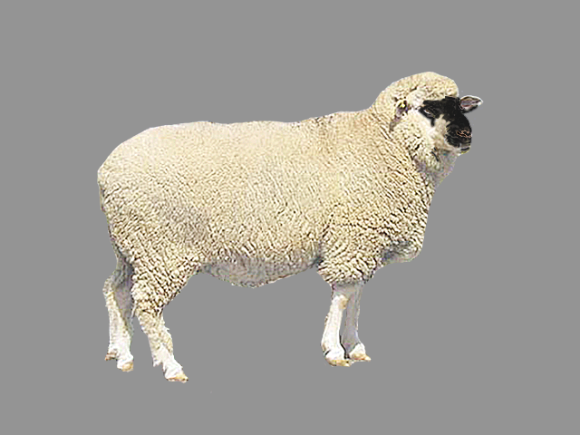
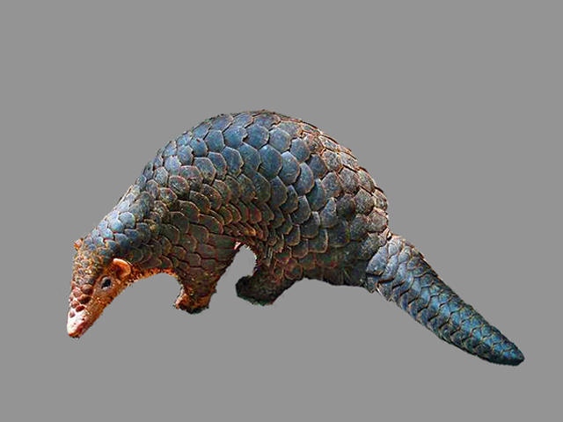
Study 1 STIMULI: Disambiguation
2 TRIAL TYPES
6 NOVEL-NAME
Where’s the nadu/capa?
8 NOVEL-VOCALIZATION
Listen [novel vocalization]
Novel animals: tapir and pangolin
Novel vocalizations: rhino grunting and gorilla snorting

Slide 19

Children chose the Novel animal when hearing a Novel animal name OR a Novel vocalization
NOVEL NOVEL
NAME VOCALIZATION

Slide 20
Children chose the Novel animal when hearing a Novel animal name OR a Novel vocalization
Disambiguation for stimuli other than words and facts
NOVEL NOVEL
NAME VOCALIZATION

Slide 21
STUDY 1
How quickly can 30-mo-olds use linguistic and non-linguistic cues to identify a familiar animal?
Do children choose a novel animal in response to a novel animal vocalization?
STUDY 2
If so, do children actually remember the mapping between the novel animal and vocalization?

Slide 22
STUDY 2: DESIGN
20 30-mo-olds
Same as STUDY 1
Fernald et al. (2008)

Slide 23
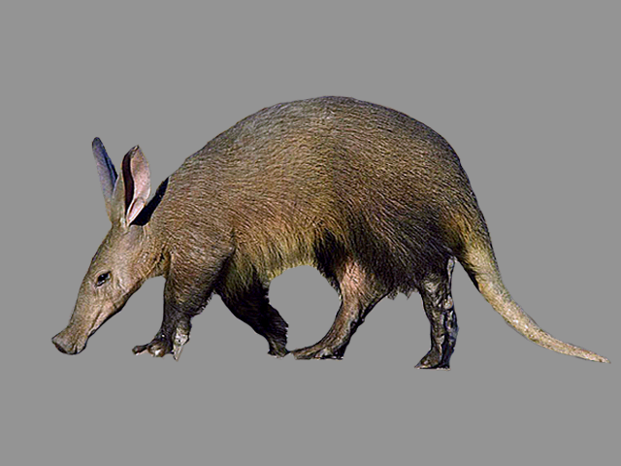
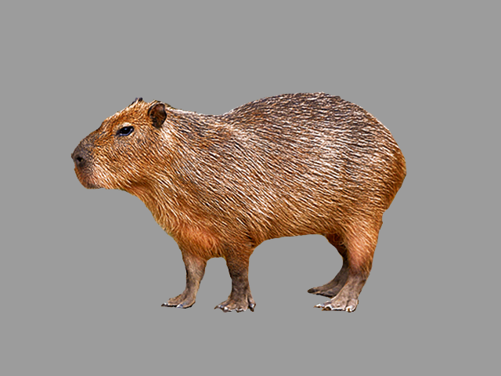
3 Trial types as in Bion, Borovsky, & Fernald (2012)
16 FAMILIAR-VOCALIZATION
8 DISAMBIGUATION
8 RETENTION
aardvark - capybara

Slide 24
On retention trials, children showed fragile evidence of remembering this mapping
FAMILIAR DISAMBIGUATION RETENTION

Slide 25
Children who did better on disambiguation did better on retention
r (18) = 0.44, p = 0.05

Slide 26
Children who did better on disambiguation did better on retention
r (18) = 0.44, p = 0.05
r (18) = 0.44, p = 0.05
Disambiguation is related to retention but not necessarily sufficient

Slide 27
Is disambiguation motivated by a single mechanism?
Children show disambiguation for stimuli other than words and facts (Bion et al., Halberda)
Different mechanisms could jointly contribute to disambiguation behavior (Lewis & Frank, in press)

Slide 28
Recent research on disambiguation
Role of experience
Byers-Heinlein & Werker; Fernald - SRCD 2011
Yurovsky, Smith, Bion, & Fernald - SRCD 2013
Relation to word learning
Horst, Samuelson, McMurray; Bion, Borovsky, & Fernald - SRCD 2011
Scope
Samuelson; Halberda; Bion et al.; Suanda & Namy - SRCD 2013

